Slide 1
Module 6: Introducing Natural Language Processing
AWS Academy Machine Learning Foundations
© 2020, Amazon Web Services, Inc. or its Affiliates. All rights reserved.
Notes:
Welcome to Module 6: Introducing Natural Language Processing.

Slide 2

Module overview
Sections
Overview of natural language processing (NLP)
Natural language processing managed services
Module wrap-up
Demonstrations
Introducing Amazon Polly
Introducing Amazon Comprehend
Introducing Amazon Translate
Lab
Guided Lab: Creating a Bot to Schedule Appointments
Knowledge check
Notes:
This module includes the following sections:
Introduction to natural language processing (NLP). This introduction includes a description of the major challenges that are faced when you work with NLP, and the overall development process for NLP applications.
A review of five AWS services that you can use to speed up the development of NLP-based applications.
This module also includes <recorded / educator-led> demonstrations that will show you how to use Amazon Comprehend, Amazon Polly and Amazon Translate by using the AWS Management Console.
The module also includes a hands-on guided lab where you will learn how to use Amazon Lex to develop a bot for scheduling appointments.
Finally, you will be asked to complete a knowledge check that will test your understanding of key concepts covered in this module.

Slide 3
Module objectives
At the end of this module, you should be able to:
Describe the natural language processing (NLP) use cases that are solved by using managed Amazon ML services
Describe the managed Amazon ML services available for NLP
Use managed Amazon ML Services
Notes:
After completing this module, you should be able to:
Describe the natural language processing (NLP) use cases that are solved by using managed Amazon ML services
Describe the managed Amazon ML services available for NLP
Use managed Amazon ML Services

Slide 4
Section 1: Overview of natural language processing
Module 6: Introducing Natural Language Processing
Notes:
Introducing Section 1: Overview of natural language processing. In this section, you will review the meaning of natural language processing.

Slide 5

Natural language processing (NLP)
“Alexa, what’s it like outside?”
Notes:
Before you see an explanation of natural language processing (NLP), look at an NLP example with Amazon Alexa.
An Amazon device, such as an Echo, records your words. The recording of your speech is sent to Amazon servers to be analyzed more efficiently.
Amazon breaks down your phrase into individual sounds. Then, it connects to a database that contains the pronunciations of various words to find which words most closely correspond to the combination of individual sounds.
It identifies important words to make sense of the tasks and to carry out corresponding functions. For instance, if Alexa notices words like outside or temperature, it opens the weather app.
Amazon servers send the information back to your device, and Alexa might speak.

Slide 6
What is NLP?
NLP develops computational algorithms to automatically analyze and represent human language.
By evaluating the structure of language, machine learning systems can process large sets of words, phrases, and sentences.
Word
Phrase
Sentence
Sentence
Phrase
Sentence
Notes:
NLP is a broad term for a general set of business or computational problems that you can solve with machine learning (ML). NLP systems predate ML. Two examples are speech-to-text on your old cell phone and screen readers. Many NLP systems now use some form of machine learning. NLP considers the hierarchical structure of language. Words are at the lowest layer of the hierarchy. A group of words make a phrase. The next level up consists of phrases, which make a sentence, and ultimately, sentences convey ideas.
NLP systems face several significant challenges, which you will learn about next.

Slide 7


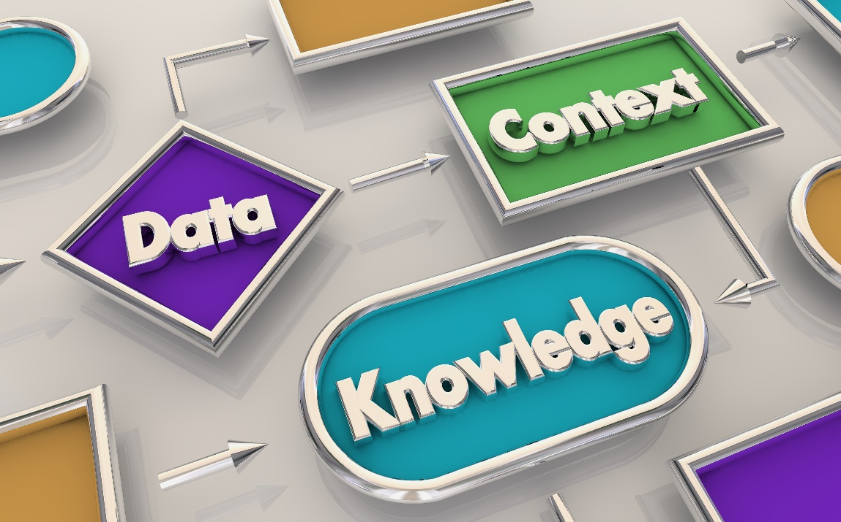
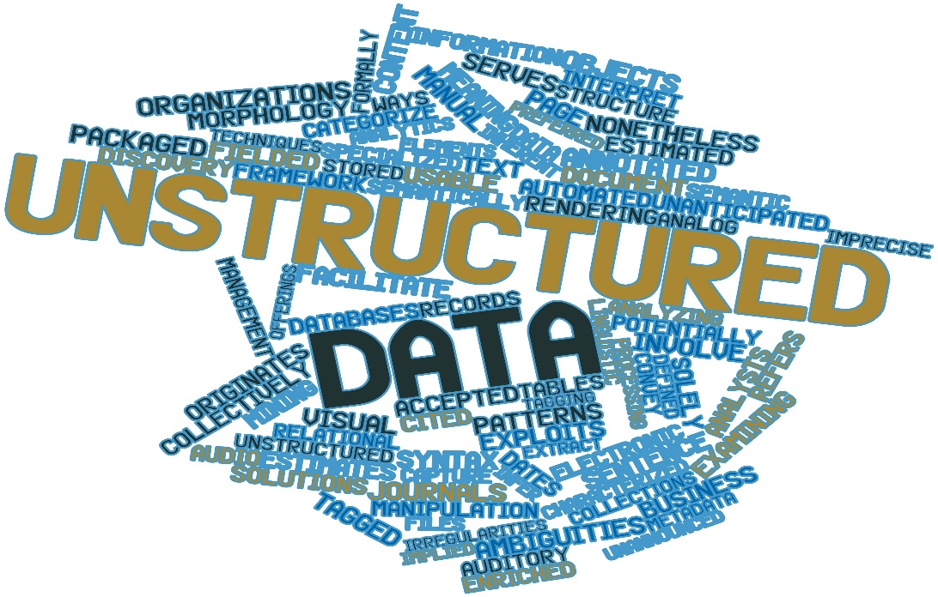
NLP challenges
Lack of precision
Many complex dependencies
Meaning that is based on context
Lack of structure
Notes:
Language is not precise. Words can have different meanings, which are based on the other words that surround them (context). Often, the same words or phrases can have multiple meanings. For example, consider the term weather. You might be under the weather, which means that you are sick. However, there is wonderful weather outside means that the weather conditions outside are good. The phrase Oh, really? might convey surprise, disagreement, or many other meanings, depending on context and inflection.
Some of the main challenges for NLP include:
Discovering the structure of the text – One of the first tasks of any NLP application is to break the text into meaningful units, such as words, phrases, and sentences.
Labeling data – After the system converts the text to data, the next challenge is to apply labels that represent the various parts of speech. Every language requires a different labeling scheme to match the language’s grammar.
Representing context – Because word meaning depends on context, any NLP system needs a way to represent context. It is a big challenge because of the large number of contexts. Converting context into a form that computers can understand is difficult.
Applying grammar – Although grammar defines a structure for language, the application of grammar is nearly infinite. Dealing with the variation in how humans use language is a major challenge for NLP systems. Addressing this challenge is where machine learning can have a big impact.

Slide 8

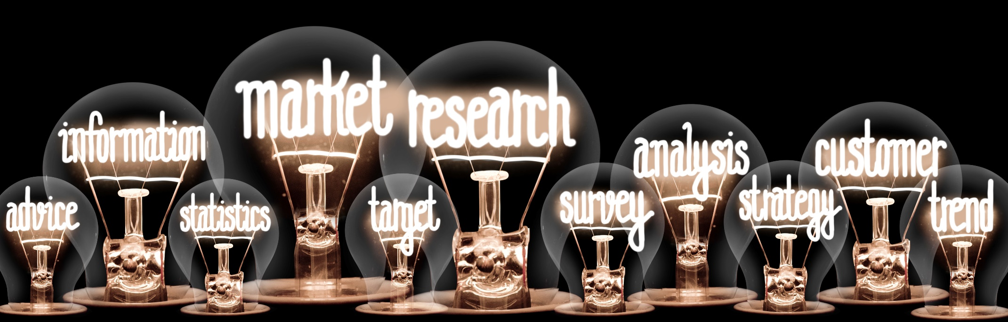


Natural language processing use cases
Search applications
Market and social research
Human machine interfaces
Chatbots
Notes:
You can apply NLP to a wide range of problems. Some of the more common applications include:
Search applications (such as Google and Bing)
Human machine interfaces (such as Alexa)
Sentiment analysis for marketing or political campaigns
Social research that is based on media analysis
Chatbots to mimic human speech in applications

Slide 9
Natural language processing flow
Deploy model
New data or retraining
Business problem
Problem formulation
Tune model
Yes
Meets business goal?
Collect and label data
Evaluate data
Feature engineering
Select and train model
Evaluate model
Preprocess text
Create tokens and analyze text
Extract meaning
No
Notes:
You can apply the ML development pipeline that you have seen throughout this course when you develop an NLP solution. The first task is to formulate a problem, and then collect and label data.
For NLP, collecting data consists of breaking the text into meaningful subsets and labeling the sets. Feature engineering is a large part of NLP applications. This process gets more complicated when you have irregular or unstructured text. For example, if you build an application to classify documents, you must be able to distinguish between words with common terms but different meanings.
Labeling data in the NLP domain is sometimes also called tagging. In the labeling process, you must assign individual text strings to different part of speech. You can use specialized tools to help with NLP labeling.

Slide 10

Preprocessing text
Common preprocessing steps –
Remove stop words
Normalize similar text
Standardize unrecognized text
Other preprocessing steps –
Encoding
Spelling and grammar checks
Multiple libraries and tools are available for preprocessing (for example, NLTK for Python)
Sample “This is sample text”
Stop words “This”, “is”
Sample “He ran for the bus because he
was running late. ”
Words to normalize “ran”, “running”
Sample “DM me ltr”
Standardize words: “DM” = “direct message”
“ltr” = “later”
Sample Preprocessing
Notes:
The first task for an NLP application is to convert the text to data so that it can be analyzed. You convert text by removing words that are not needed for the analysis from the input text. In the example, the words This and is are removed to leave the phrase sample text.
After you remove these stop words, you can normalize text by converting similar words into a common form. For example, the words run, runner, ran, and running are all different forms of the word run. You can normalize all instances of these words within a block of text by using processes of stemming and lemmatization.
After you normalize the text, you can standardize it by removing words that are not in the dictionary that you use for analysis. Examples include acronyms, slang, and special characters.
The Natural Language Toolkit (NLTK) Python library provides functions that you can use to remove stop words, normalize, and standardize text.

Slide 11
Creating tokens and feature engineering
Load data by using tokens
You can use tokens to convert words into items in a DataFrame
Develop features by applying a model
Common models include bag of words and term frequency and inverse document frequency (TF-IDF)
from nltk.tokenize import word_tokenize
text = “this is some sample text.”
Print(word_tokenize(text))
Output: [‘this’,‘is’,‘some’,‘sample’,‘text’ ‘.’]
Sample token code
Notes:
One of the first steps for creating an NLP system is to convert the text into a data collection, such as a DataFrame. All the NLP libraries provide functions to assist with this type of conversion. This example shows how to use the word_tokenize function that’s provided in the NLTK library.
After you clean up your text and load it into a DataFrame, you can apply one of the NLP models to create features.
Common models include:
Bag of words – This simple model captures the frequency of words in a document. For each word in the document, a key is created, with a value that is the number of occurrences within that document.
Term frequency and inverse document frequency (TF-IDF) – Term frequency is a count of how many times a word appears in a document. Inverse document frequency is the number of times a word occurs in a group of documents. These two values are used together to calculate a weight for the words. Words that frequently appear in many documents have a lower weight.

Slide 12
Example NLP model: Bag of words
Create a vector for each sentence or phrase
Evaluate words in a sentence that is based on frequency
Frequency creates a vector for each sentence or phrase
Today is Wednesday and it is my birthday.
Today
is
Wednesday
and
it
my
birthday
1
2
1
1
1
1
1
Bag of words vector
Example NLP Model
Notes:
Many models have been established in the NLP field. This example shows the bag of words model. Bag of words is a vector model. Vector models convert each sentence or phrase into a vector, which is a mathematical object that records both directionality and magnitude. In the example, a simple sentence is converted into a vector where each word is recorded in terms of frequency. The word is has a value of 2 because it appears twice in the sentence.
Bag of words is often used to classify documents into different categories. Bag of words is also used to derive attributes that feed into NLP applications, such as sentiment analysis.

Slide 13
Text analysis categories
Classifying text
Discovering similarities
Deriving relationships
dog
cat
There iz an error in this sentence.
I
love
ice cream.
cow
is
Dictionary
subject
verb
object
Animals
Notes:
Text analysis has three broad categories:
Classifying text – This category of analysis is similar to other classification systems that you have seen in this course. Text provides the input to a process that extracts features, which are then sent though an ML algorithm. This algorithm interacts with a classifier model to infer the classification. You can use the NLTK Python library to create a classification system.
Discovering similarities – Text matching has many applications. For example, auto-correct, spell check, and grammar check are all based on text matching. The edit distance (also known as the Levenshtein distance) algorithm is frequently used.
Deriving relationships – You can derive relationships between different words or phrases in the text by using a process called coreference resolution. Several NLP systems provide Python libraries for deriving relationships.

Slide 14


Capture context
Understanding context for the text is a major challenge for NLP:
Tagging words with the appropriate part of speech helps to capture context
NLP libraries provide token functions to help with tagging
Context computing
Context medicine
Notes:
One of the largest challenges for NLP is how to describe the context for the text. Consider the example where a user is searching for the term tablet. Because the word tablet has at least two distinct meanings, the search engine must know which meaning the user has in mind. The term might be qualified further (for example, by adding another term like medicine or computing). If it’s not qualified by other terms, then most search engines rely on the most commonly used context.

Slide 15
Derive meaning by entity extraction
Extract entities by using named entity recognition (NER):
Identify noun phrases
Classify phrases by using a classification algorithm
Disambiguate entities by using a knowledge graph
The ocean liner Titanic sank in the North Atlantic.
“ship”: “Titanic”
“location”: “North Atlantic”
Named Entities
Notes:
The process of extracting entities is known as named entity recognition (NER). A NER model has the following components:
Identify noun phrases by using dependency charts and part of speech tagging
Classify phrases by using a classification algorithm, such as Word2Vec
Disambiguate entities by using a knowledge graph
This example shows how to use NER to extract the entities Titanic and North Atlantic from the text. After the named entities are extracted, you can use a knowledge graph to extract meaning. A knowledge graph combines subject matter expertise with machine learning to derive meaning. The Amazon recommendations engine is an example of a knowledge graph.

Slide 16

Section 1 key takeaways
As a domain, NLP predates machine learning
NLP development maps directly to the ML development process
Some of the main use cases for NLP are search query analysis, human-machine interaction, and market or social research
NLP is difficult because of the imprecise nature of human language
Notes:
Some key takeaways from this section of the module include:
As a domain, NLP predates machine learning.
NLP development maps directly to the ML development process.
Some of the main use cases for NLP are search query analysis, human-machine interaction, and market or social research.
NLP is difficult because of the imprecise nature of human language.

Slide 17
Section 2: Natural language processing managed services
Module 6: Introducing Natural Language Processing
Notes:
Introducing Section 2: Natural language processing managed services. In this section, you will review five managed Amazon ML services that you can use for various NLP use cases. These services simplify the process of creating a NLP application.

Slide 18

Amazon Transcribe
Amazon Transcribe is a fully managed service that uses advanced machine learning technologies to recognize speech in audio files and transcribe them into text. You can use Amazon Transcribe to convert audio to text and to create applications that incorporate the content of audio files.
Amazon Transcribe
Recognize recorded voices
Convert streaming audio to text
Customize specialized vocabularies
Integrate with applications by using WebSockets
Build subtitles for multiple languages in real time
Notes:
Amazon Transcribe is the first managed machine learning service that you will learn about. You can use Amazon Transcribe to recognize speech in audio files and produce a transcription. Amazon Transcribe can recognize specific voices in an audio file, and you can create customized vocabulary for terms that are specialized for a particular domain. You can also add transcription service to your applications by integrating with WebSockets. WebSockets provide an internet-facing interface that enables two-way communication between an application and Amazon Transcribe.

Slide 19




Amazon Transcribe use cases
Medical transcription
Subtitles
Streaming content labeling
Call center monitoring
Notes:
Some of the more common use cases for Amazon Transcribe include:
Medical transcription – Medical professionals can record their notes, and Amazon Transcribe can capture their spoken notes as text.
Video subtitles – Video production organizations can generate subtitles automatically from video. It can also be done in real time for a live feed to add closed captioning (CC).
Streaming content labeling – Media companies can capture and label content, and then feed the content into Amazon Comprehend for further analysis.
Customer call center monitoring – Companies can record customer service or sales calls, and then analyze the results for training or strategic opportunities.

Slide 20

Amazon Polly
Amazon Polly is a managed service that converts text into lifelike speech. Amazon Polly supports multiple languages and includes various lifelike voices.
Amazon Polly
Generate voice from plain text or Speech Synthesis Markup Language (SSML) format
Create output in multiple audio formats
Offers a pay-for-use policy and uses AWS infrastructure to keep costs low
Notes:
Amazon Polly can convert text into lifelike speech. You can input either plaintext files or a file in Speech Synthesis Markup Language (SSML) format. SSML is a markup language that you can use to provide special instructions for how speech should sound. For example, you might want to introduce a pause in the flow of speech. You can add an SSML tag to instruct Amazon Polly to pause between two words.
You can also output speech from Amazon Polly to MP3, Vorbis, and pulse-code modulation (PCM) audio stream formats.
Amazon Polly has various applications. Common use cases for Amazon Polly include mobile apps (such as newsreaders), games, eLearning platforms, and accessibility applications for visually impaired people.
Amazon Polly is eligible for use with regulated workloads for the U.S. Health Insurance Portability and Accountability Act of 1996 (HIPAA), and the Payment Card Industry Data Security Standard (PCI DSS).

Slide 21




Amazon Polly use cases
News service production
Language training
Navigation systems
Animation production
Notes:
Some of the more common use cases for Amazon Polly include:
News service production – Major news companies use Amazon Polly to generate vocal content directly from their written stories.
Language training systems – Language training companies use Amazon Polly to create systems for learning a new language.
Navigation systems – Amazon Polly is embedded in mapping application programming interfaces (APIs) so that developers can add voice to their geo-based applications.
Animation production – Animators use Amazon Polly to add voices to their characters.

Slide 22
Demonstration: Introducing Amazon Polly
Notes:
Your instructor will now either demonstrate Amazon Polly or provide you with access to a recorded demonstration.

Slide 23

Amazon Translate
Amazon Translate is a fully managed text translation service that uses advanced machine learning technologies to provide high-quality translation on demand.
Amazon Translate
Develop multilingual user experiences for your applications
Translate documents to multiple languages
Analyze incoming text in multiple languages
Notes:
With Amazon Translate, you can create multilanguage experiences in your applications. You can create systems for reading documents in one language, and then render or storing it in another language. You can also use Amazon Translate as part of a document analysis system.
Amazon Translate is fully integrated with other Amazon ML services, such as Amazon Comprehend, Amazon Transcribe, and Amazon Polly. With this integration, you can:
Extract named entities, sentiment, and key phrases by integrating with Amazon Comprehend
Create multilingual subtitles with Amazon Transcribe
Speak translated content with Amazon Polly

Slide 24

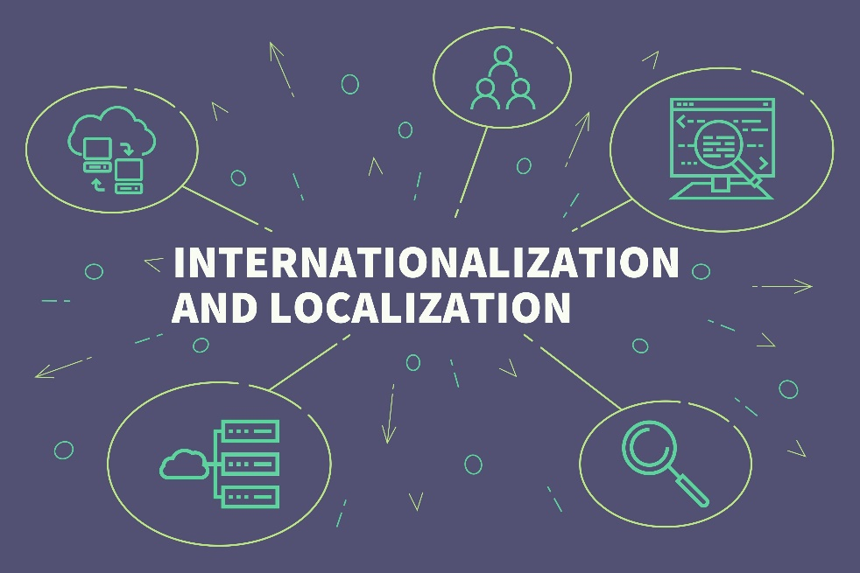


Amazon Translate use cases
International websites
Software localization
Multilingual chatbots
International media
Notes:
Some of the more common use cases for Amazon Translate include:
International websites – You can use Amazon Translate to quickly globalize your websites.
Software localization – Localization is a major cost for all software that is aimed at a global audience. Amazon Translate can decrease software development time and significantly reduce costs for localizing software.
Multilingual chatbots – Chatbots are used to create a more human-like interface to applications. With Amazon Translate, you can create a chatbot that speaks multiple languages.
International media management – Companies that manage media for a global audience use Amazon Translate to reduce their costs for localization.

Slide 25
Demonstration: Introducing Amazon Translate
Notes:
Your instructor will now either demonstrate Amazon Translate or provide you with access to a recorded demonstration.

Slide 26

Amazon Comprehend
Amazon Comprehend uses NLP to extract insights about the content of documents. It develops insights by recognizing the entities, key phrases, language, sentiments, and other common elements in a document.
Amazon Comprehend
Extract key entities from a document, such as people or locations
Identify the language that is used in a document
Determine the sentiment—such as positive, negative, neutral, or mixed—that is expressed in a document
Identify the part of speech for individual words in a document
Notes:
Amazon Comprehend implements many of the NLP techniques that you reviewed earlier in this module. You can extract key entities, perform sentiment analysis, and tag words with parts of speech.

Slide 27




Amazon Comprehend use cases
Document analysis
Fraud detection
Mobile app analysis
Content management
Notes:
Some of the more common use cases for Amazon Comprehend include:
Analysis of legal and medical documents – Legal, insurance, and medical organizations have used Amazon Comprehend to perform many of the NLP functions that you learned about in this module.
Financial fraud detection – Banking, financial, and other institutions have used Amazon Comprehend to examine very large datasets of financial transactions to uncover fraud and look for patterns of illegal transactions.
Large-scale mobile app analysis – Developers of mobile apps can use Amazon Comprehend to look for patterns in how their apps are used so they can design improvements.
Content management – Media and other content companies can use Amazon Comprehend to tag content for analysis and management purposes.

Slide 28
Demonstration: Introducing Amazon Comprehend
Notes:
Your instructor will now either demonstrate Amazon Comprehend or provide you with access to a recorded demonstration.

Slide 29

Amazon Lex
Amazon Lex is an AWS service for building conversational interfaces for applications by using voice and text. With Amazon Lex, the same conversational engine that powers Amazon Alexa is now available to any developer.
Amazon Lex
Build a chatbot that can interact with voice and text to ask questions, get answers, or complete tasks
Automatically scale your chatbot with AWS Lambda
Store log files of conversations for analysis
Notes:
With Amazon Lex, you can add a human language frontend to your applications. Amazon Lex enables you to use the same conversational engine that powers Amazon Alexa. You can automatically increase capacity by creating AWS Lambda functions to scale on demand. In addition, you can store log files of the conversations for further analysis.

Slide 30




Amazon Lex use cases
Inventory and sales
Interactive assistants
Customer service interfaces
Database queries
Notes:
Some of the more common use cases for Amazon Lex include:
Building frontend interfaces for inventory management and sales – Voice interfaces are becoming more common. Companies use Amazon Lex to add chatbots to their inventory and sales applications.
Developing interactive assistants – By combining Amazon Lex with other ML services, customers create more sophisticated assistants for many different industries.
Creating customer service interfaces – Human-like voice applications are quickly becoming the norm for customer service applications. Amazon Lex can reduce the time and increase the quality of these chatbots.
Query databases with a human-like language – Amazon Lex is combined with other AWS database services to create sophisticated data analysis applications with a human-like language interface.

Slide 31
Section 2 key takeaways
Amazon Transcribe can automatically convert spoken language to text
Amazon Polly can convert written text to spoken language
Amazon Translate can create real-time translation between languages
Amazon Comprehend automates many of the NLP use cases that are reviewed in this module
Amazon Lex can create a human-like interface to your applications
Notes:
Some key takeaways from this section of the module include:
Amazon Transcribe can automatically convert spoken language to text.
Amazon Polly can convert written text to spoken language.
Amazon Translate can create real-time translation between languages.
Amazon Comprehend automates many of the NLP use cases that are reviewed in this module.
Amazon Lex can create a human-like interface to your applications.

Slide 32

Module 6 – Guided Lab: Creating a Bot to Schedule Appointments
Notes:
You will now complete Module 6 – Guided Lab: Creating a Bot to Schedule Appointments.

Slide 33
Module wrap-up
Module 6: Introducing Natural Language Processing
Notes:
It’s now time to review the module and wrap up with a knowledge check.

Slide 34
Module summary
In summary, in this module you learned how to:
Describe the natural language processing (NLP) use cases that are solved by using managed Amazon ML services
Describe the managed Amazon ML services available for NLP
Use managed Amazon ML Services
Notes:
In summary, in this module, you learned how to:
Describe the natural language processing (NLP) use cases that are solved by using managed Amazon ML services
Describe the managed Amazon ML services available for NLP
Use managed Amazon ML Services

Slide 35
Complete the knowledge check
Notes:
It is now time to complete the knowledge check for this module.

Slide 36
Additional resources
What is Amazon Comprehend?
What is Amazon Polly?
What is Amazon Lex?
What is Amazon Transcribe?
What is Amazon Translate?
Notes:
If you want to learn more about the topics that are covered in this module, you might find the following resources helpful:
What is Amazon Comprehend?
What is Amazon Polly?
What is Amazon Lex?
What is Amazon Transcribe?
What is Amazon Translate?

Slide 37
Thank you
Notes:
Thank you for completing this module.

